Slide 1
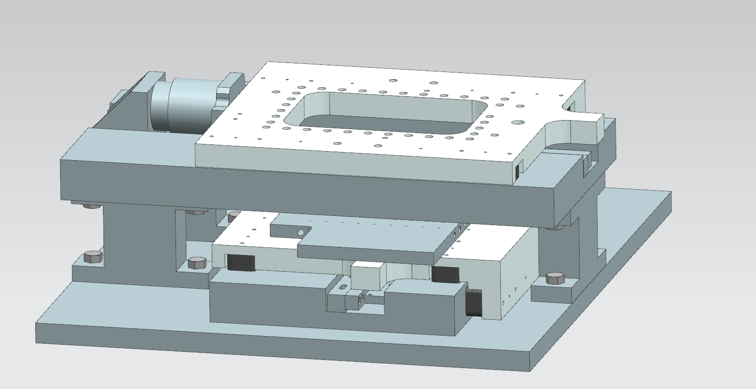
Overview of the two-axis air bearing stage that will be used in the second phase of the student challenge in 2021
The flexure mechanism built using Mechblocks
would be attached to this platform (Tool platform)
x
y
The material to be scribed will be placed on this surface
(specimen platform)

Slide 2
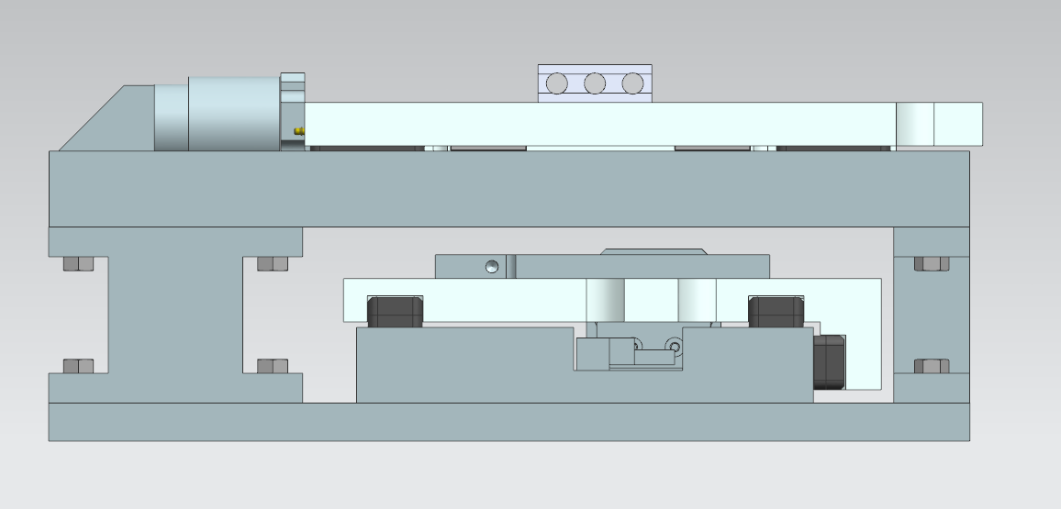
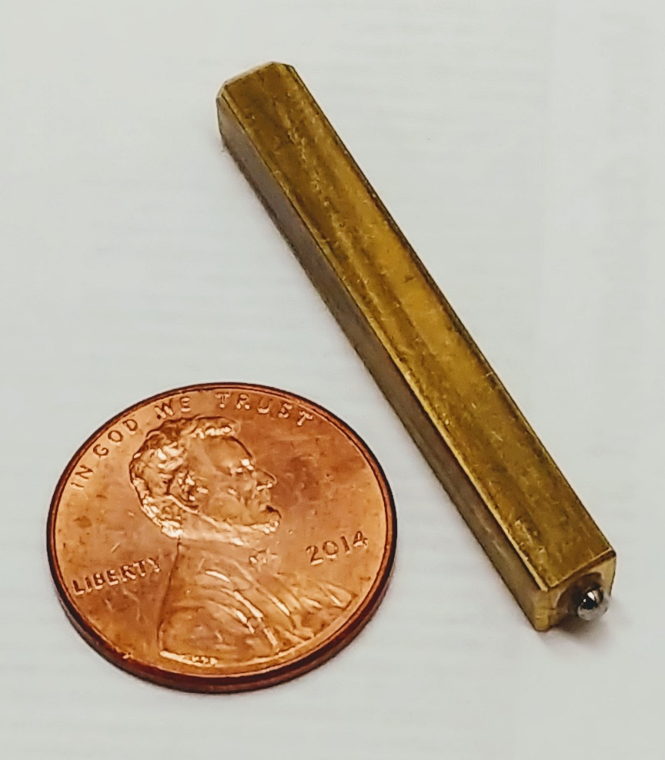
Dimensional constrain of the flexure mechanism to be designed in 2020
Force tool
51 mm
The dimensions of the flexure mechanism must be designed in a way that the force tool attached to the mechanism makes contact at the specimen platform

Slide 3
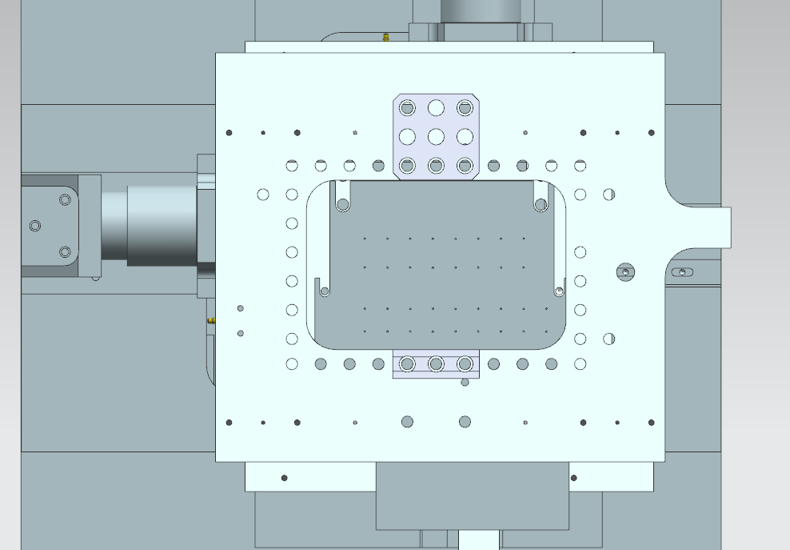
Dimensional constrain of the flexure mechanism to be designed in 2020
74.55 mm
114.3 mm
Are the teams required to design their mechanism in a way it fits inside this rectangle? KA

Slide 4
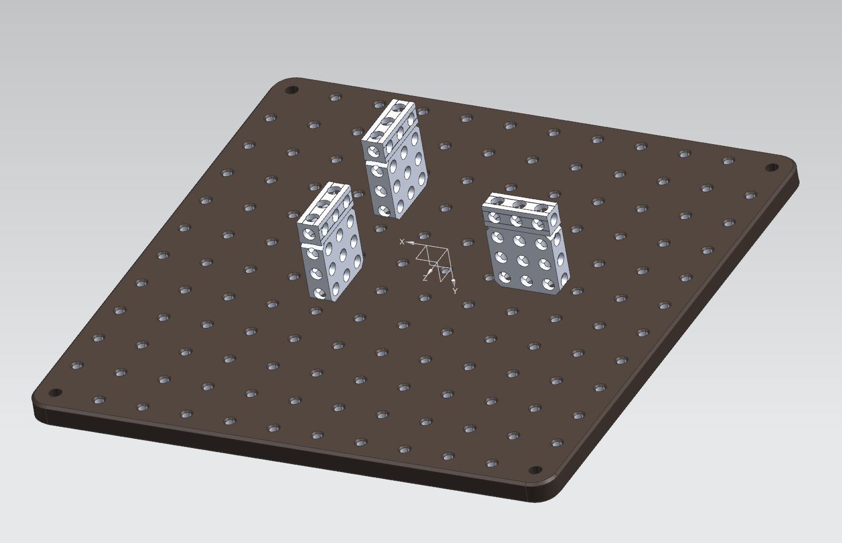
To emulate dimensional constraints of the air bearing stage
114.3mm
3 sets of blocks will be sufficient but if you need more please add as you need
74.5 mm
3x3 and 3X1 Mechblocks (total height of 51mm) would be attached to two ½ inch thick bread boards. One of them is cut to the emulate the dimensions of the tool platform. spacing needed

